Slide 1


Heya Plus Size
Business Model Canvas

Slide 2
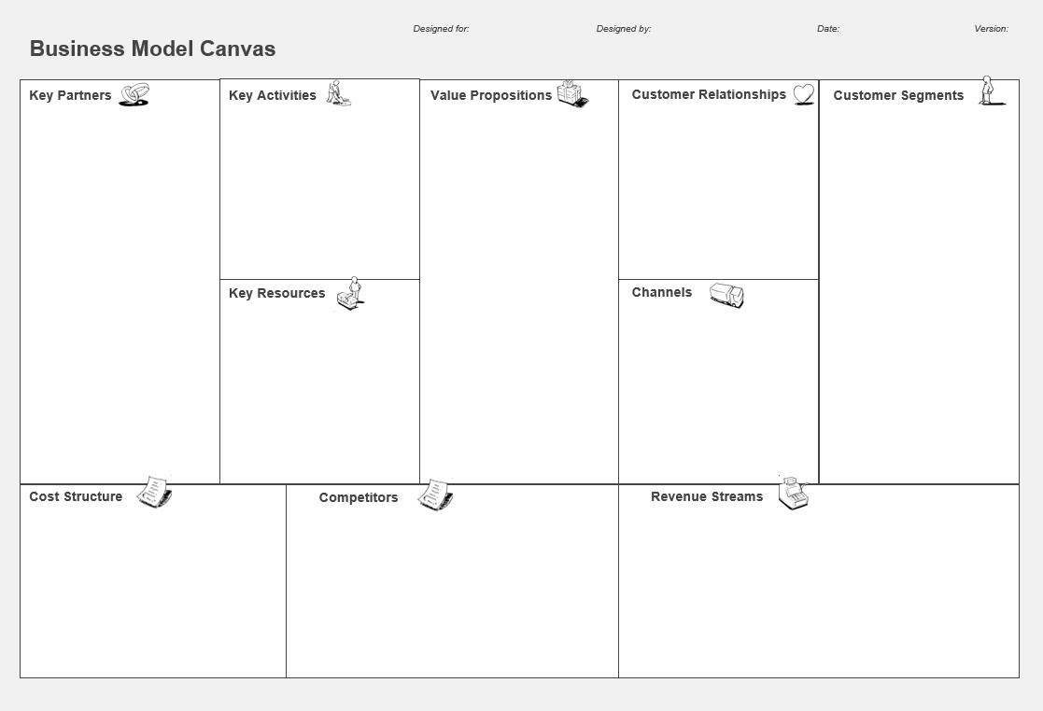
Designed for: Heya Plus Size Designed By: Sara Hussein Date: 15th October 2024
Key Partners
Key Activities
Value Proposition
Customer Relationships
Customer Segment
Subscription Services
Fashion Designers
Manufacturers
Suppliers
Shipping Companies
Influencers and bloggers
Retail Partners
Marketing team
E-commerce Platform
Graphic designer
Photographer
Social Media platforms
Reels maker
Website developer
Customer Service Providers
Social Media Management system
CRM System
Market Research
Design Sourcing
Quality Review
Content Creation
Influencer Collaboration
Website Updates
Customer Service
Order Management
Data Collection
Packaging
Shipping Coordination
Customer Follow-Up
Trend Analysis
Build a supportive community by engaging with customers through giveaways, responsive communication, and penetration pricing to build loyalty, Comfortability, and happiness.
Sales offer
PR campaign
Body positive, trendy clothing that promotes self love and confidence, with a perfect fit for all body types.
Women in Egypt, aged 25-45, single and married, middle to upper-middle class, well educated, seeking fashionable plus size clothing.
Key Resources
Channels
Raw Materials
Financial Resources
Suppliers
Inventory
Customer Service Team
Industry Experts
E-Commerce Website
Analytics Tools
Influencers
Fashion Designers
Distributors
Manufacturers
Shipping Companies
Retailers
Social Media Platforms
Marketing Resources
CRM System
Website
Facebook
Instagram
TikTok
Cost Structure
Raw Material Costs
Production Expenses
Marketing Expenses
E-commerce Platform Fees
Inventory Holding Costs
Customer Service Expenses
Influencer Collaboration Costs
Design and Development Costs
Operational Expenses
Rent
Taxes
Salaries
Internet
Licensing Fees
Shipping Costs
Sourcing
Software and Tools Costs
Competitors' Weaknesses
Limited Awareness Compared to Competitors
Restricted Sizes
Higher Prices
Limited Presence in the Egyptian Market
Shipping Delays
Revenue stream
Competitors' Strengths
Focus on High-Quality Fabrics
Local Expertise
High Funding
Personalized Styling
Established Brand Loyalty
Local Understanding of Consumer Needs
Direct sale
Online Promotions
Loyalty Programs
Event booths

Slide 3
SWOT Analysis

Slide 4
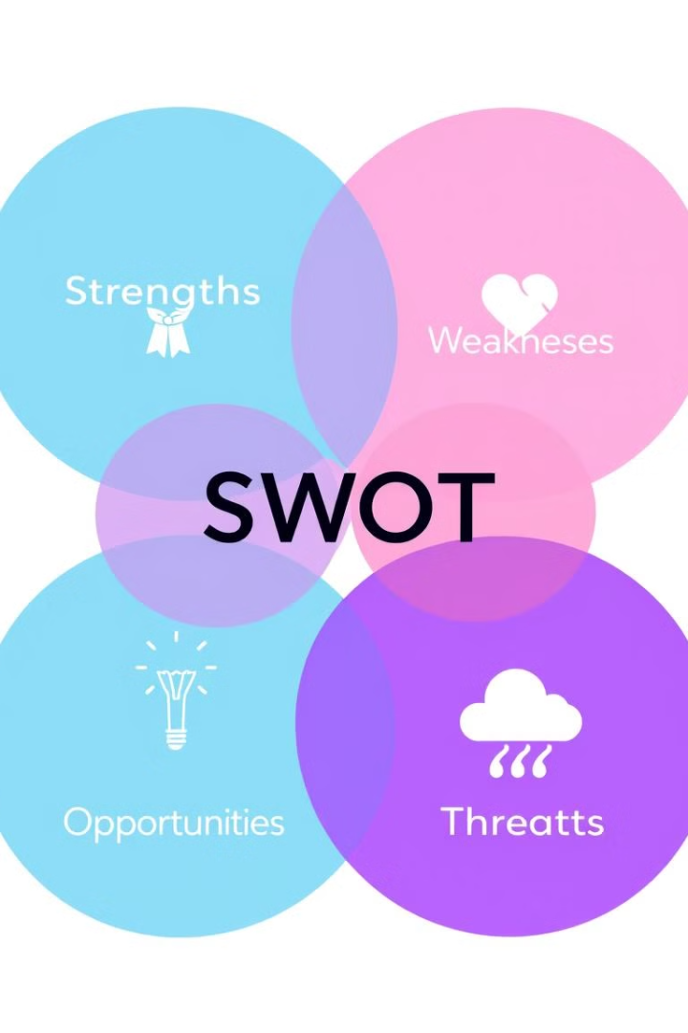
Strengths
Product Variety
Digital Marketing Expertise
Marketing Activities
Trend Diversification
High Quality Products
Trendy Styles
Body Positivity Philosophy
Weaknesses
Limited Financial Resources
Low Experience
Limited Brand Recognition
Production Delays
Low Profit Margins
Opportunities
Cultural Fit
Online Expansion
Changing Preferences
Growing Market
Minimal Competitors
Threats
Economic Uncertainty
Supply Chain Disruptions
Niche Market Risks
Currency Dependency
Potential New Entrants
Challenges with Distributors
Brand Loyalty of Competitors

Slide 5
SMART Objectives

Slide 6
SMART Objectives
1
Brand Awareness
In the first 6 months, aim to Reach 25,000 unique users, generate 100,000 impressions, and increase to 1,000 by the end of Month 6 to establish a strong online presence.
2
Social Media Growth &Engagement
In the next 3 months, focus on gaining 10,000 new followers and increasing total post engagement to 5,000 interactions to build a dedicated community
3
Website Traffic
in the following 3 months, target achieving a total of 15,000 website visits to drive more potential customers to our platform.
4
Conversation Rate
In the next 3 months, strive for 10 successful conversions per week, reduce cart abandonment to 15-25 cases per month, and increase revenue growth by 40-60% to enhance business profitability.

Slide 7
Target Market

Slide 8
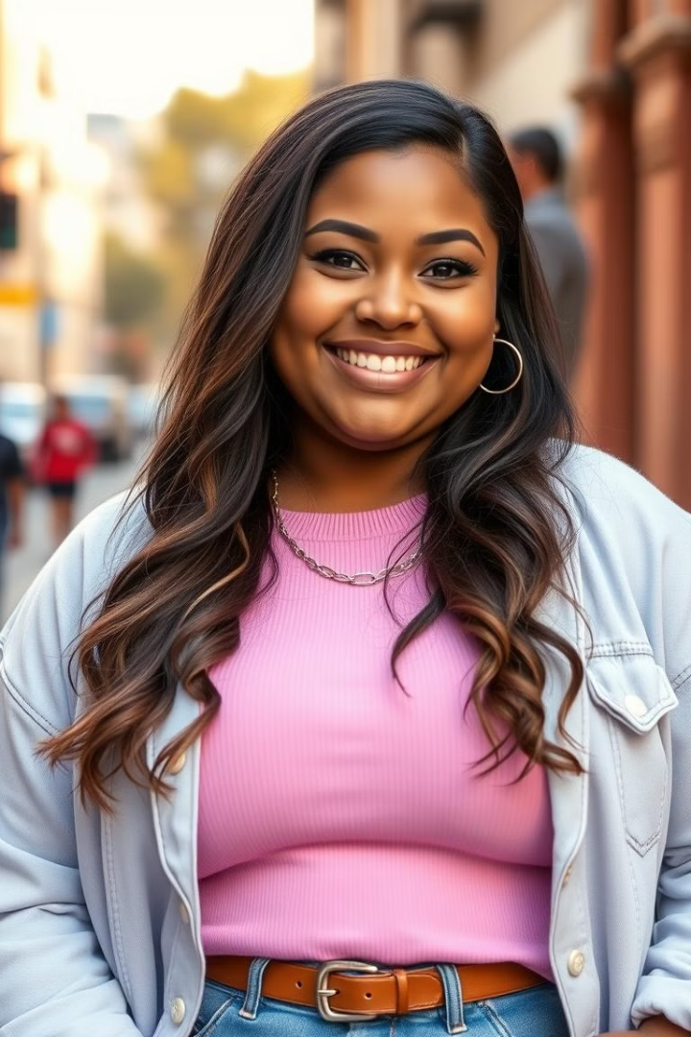
Persona 1: Yara
Demographics
Age: 28, Location: Alexandria, Occupation: HR Manager, Marital Status: Single, Weight: 95 kg, Education: Bachelor
Interests
Online shopping, social activities with friends
Needs
Trendy fashion and elegant fit to enhance confidence
Motivations
Real customer reviews, recommendations from trusted influencers, variety of styles and colors

Slide 9
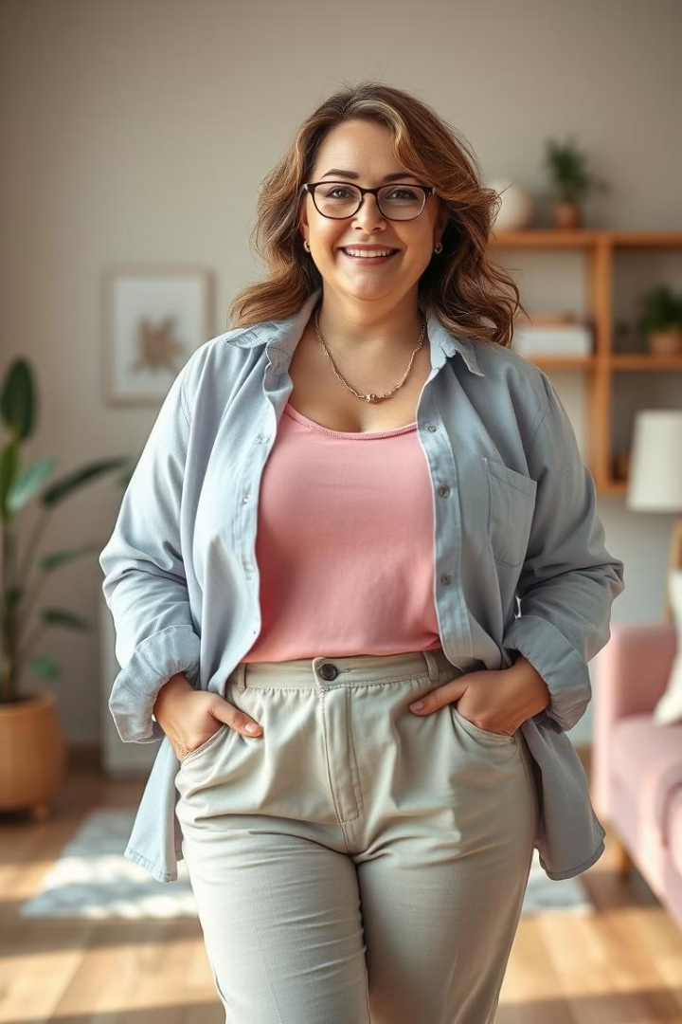
Persona 2: Nariman
Demographics
Age: 39, Location: Cairo, Occupation: Housewife, Marital Status: Married, Two Children, Weight: 120 kg, Education: Bachelor.
Interests
Clubs, family events, cooking.
Needs
Everyday clothes that are comfortable, practical, high quality, and suitable price.
Motivations to Buy
Offers, suitable price, recommendations and reviews from mom influencers.

Slide 10
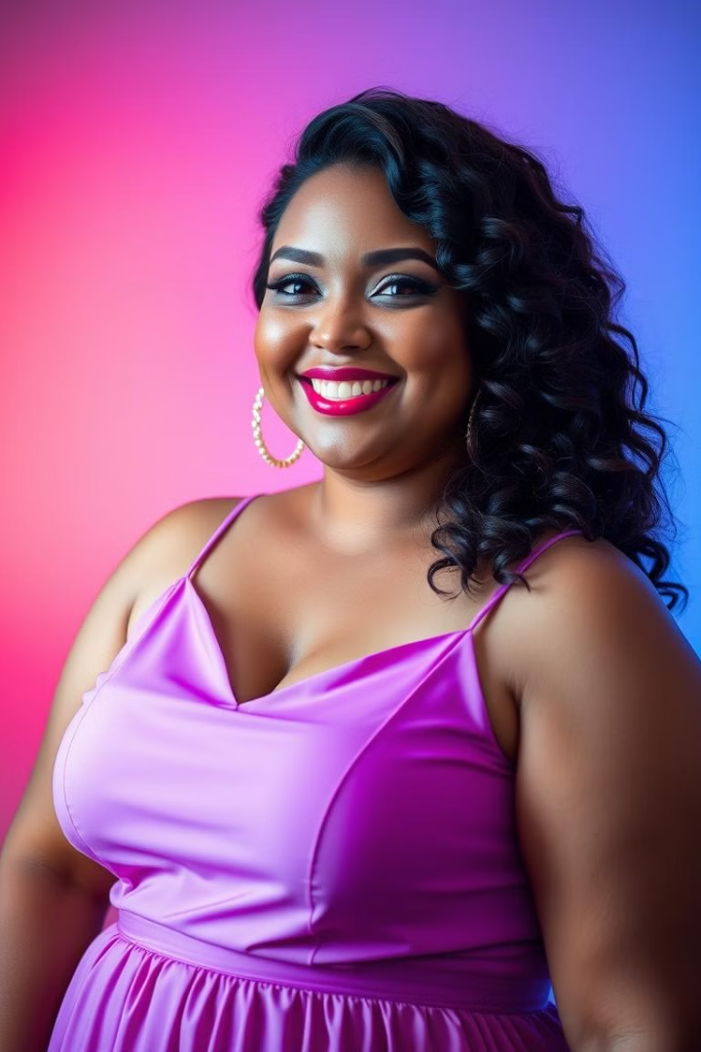
Our Value Proposition
Confidence Boosting
Helping women feel confident by providing stylish, comfortable clothing that fits every body shape.
Trend-Focused
Offering a wide selection of fashionable designs that cater to current trends.
Inclusive Fit
Meticulously crafted clothing that enhances comfort and style for all body types.

Slide 11
Marketing Mix (4Ps)

Slide 12
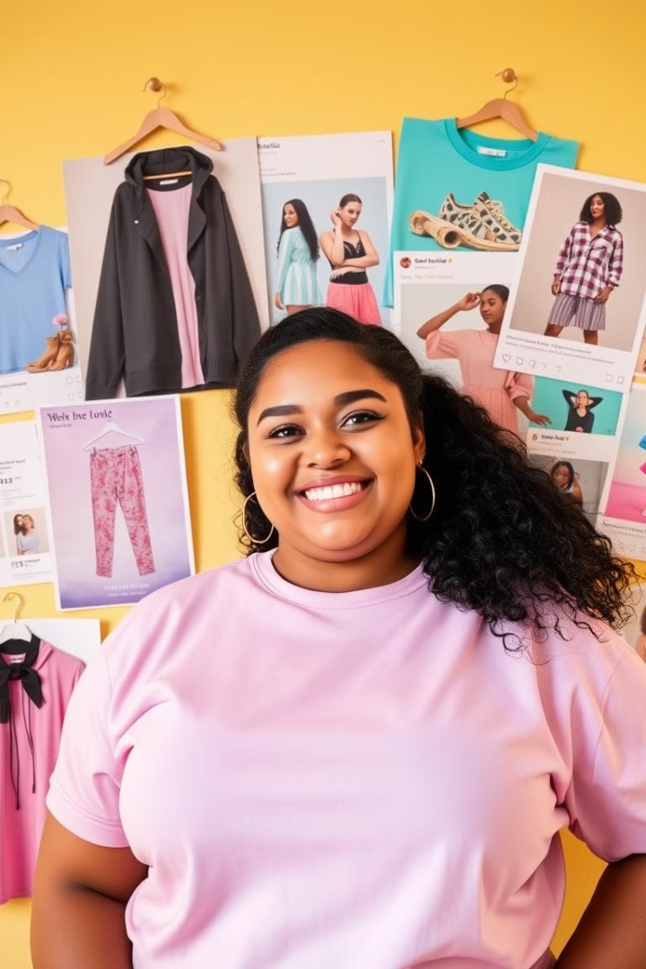
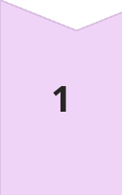
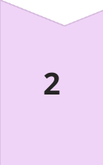
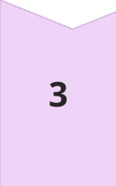
Product
specifically designed for plus-size women.
Fabrics: High quality materials to ensure comfort.
Variety: A wide selection of styles and colors tailored to preferences and current trends.
Manufacturing: Meticulously crafted to enhance comfort and style
Price
Penetration Strategy
Class B and B+
Starting from 400 EGP to 2500 per item
Place
Online Retail: Website: Our e-commerce platform facilitates hassle free shopping.
Social Media Sales: Engaging with customers and highlighting products on Facebook and Instagram for direct shopping features

Slide 13
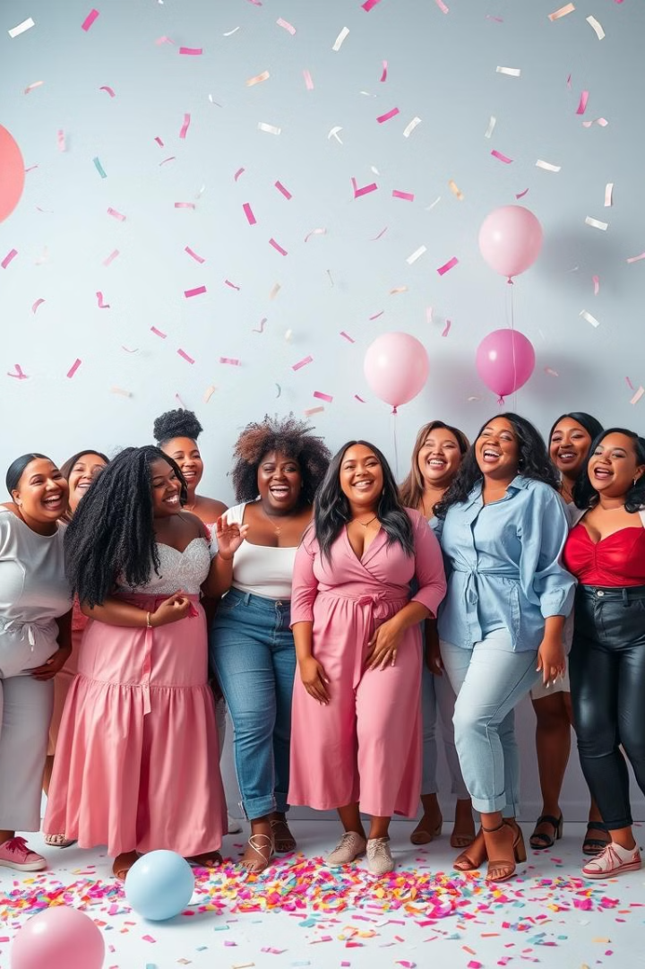
Promotion
1
Social Media Campaigns
Targeted advertising on Facebook and Instagram, engaging content for the plus-size community.
2
Website Engagement
Optimize website for user experience and easy navigation, implement SEO strategies to increase organic traffic.
3
Influencer Partnerships
Partner with plus-size influencers to expand reach, use UGC to enhance authenticity and engagement.
4
Well-Trained Moderators
Ensure smooth communication and brand representation across social media and the website, manage customer interactions, answer questions, and ensure positive engagement on all platforms.

Slide 14
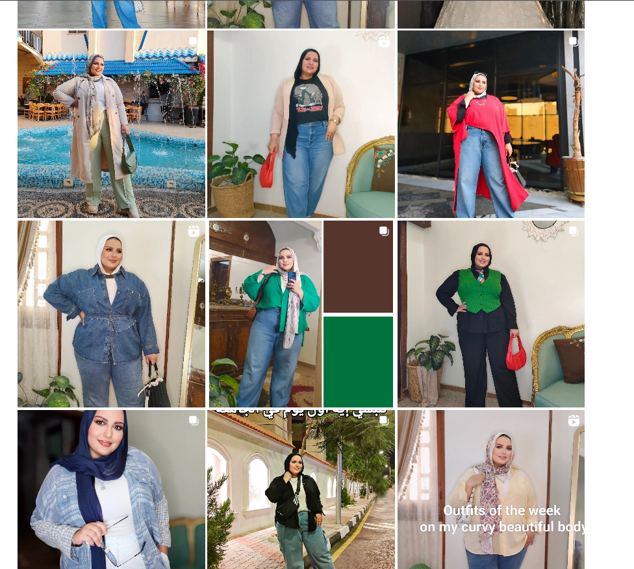
Influencer Basma Azzam

Slide 15
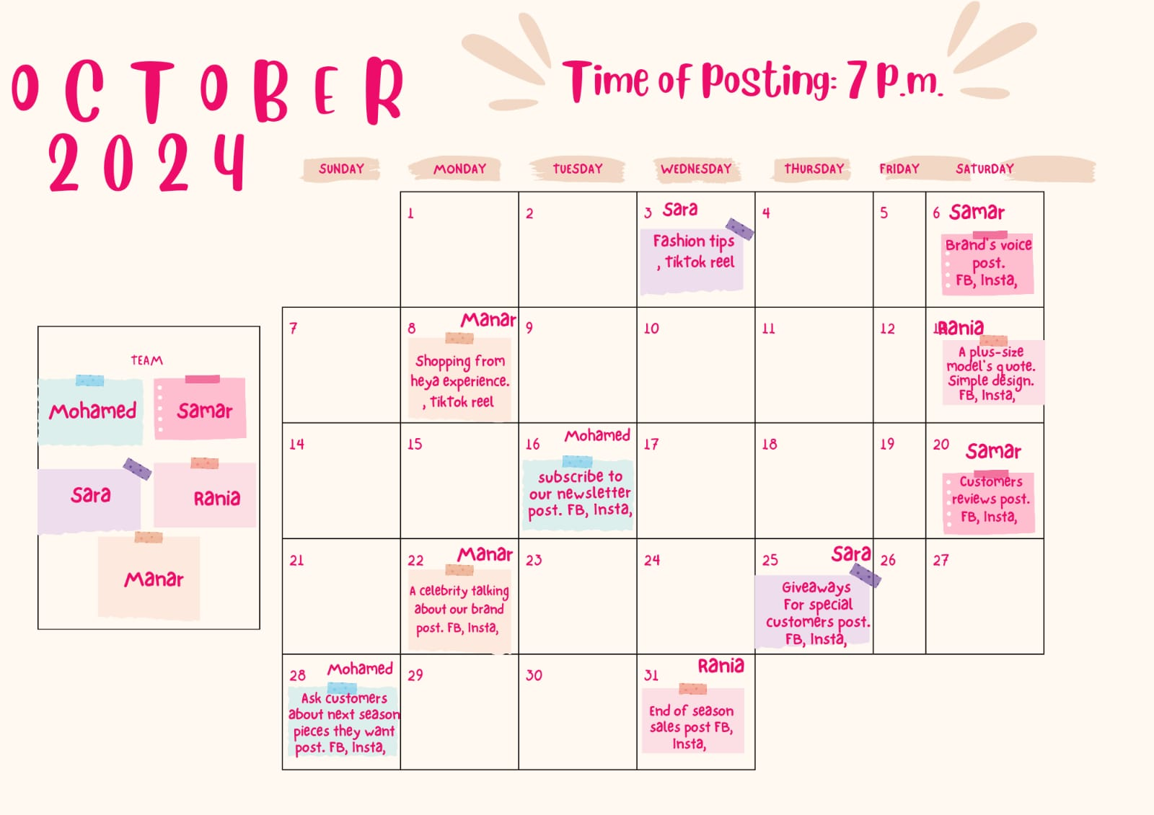
Content Calendar
Date
Platform
Content Idea
Creator
October 8
Facebook & Instagram
Style Tips for Different Body Shapes
Sara
October 10
Instagram
Outfit of the Week
Rania
October 12
Instagram
Body Positivity Quotes
Samar
October 14
Facebook & Instagram
Limited-Time Offer or Discount
Mohamed
October 16
Facebook & Instagram
New Arrival Teasers
Manar

Slide 16
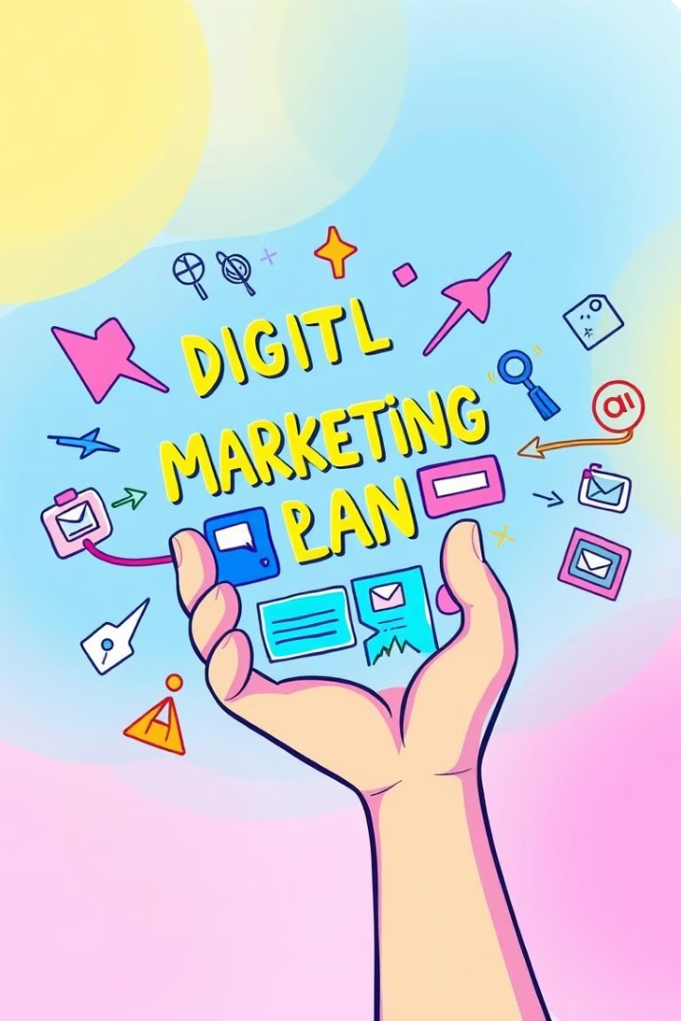
Action Plan

Slide 17
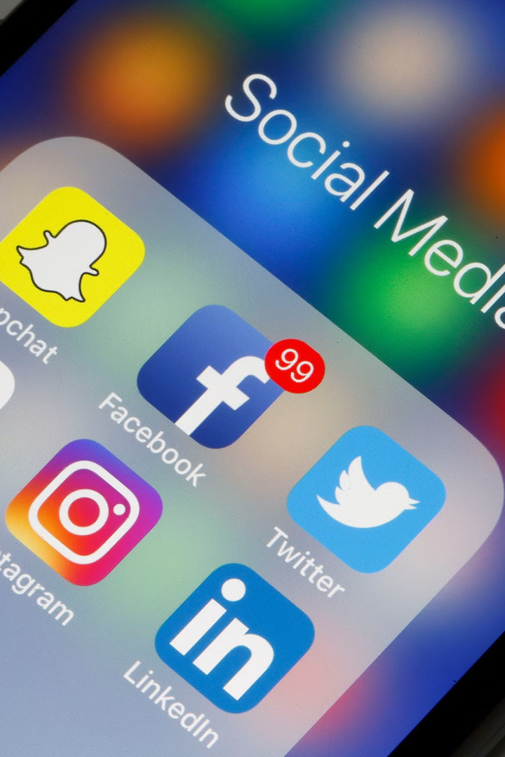
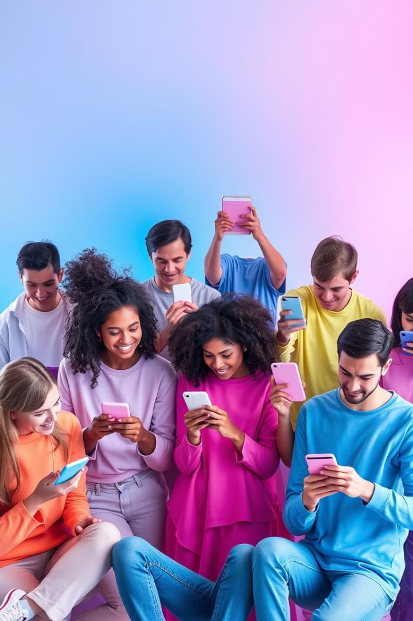
Brand Awareness
Start date: October 1st
Minimum Cost: 15,000EGP
Action 1:
Action 2:
Action 3:
Launch Campaign
Run brand awareness campaigns on Facebook and Instagram.
Influencer Collaboration
Partner with influencers in the Plus Size Fashion industry.
Share Brand Stories
Show brand stories and testimonials across social media.

Slide 18
2. Social Media Growth &Engagement
Start date: Beginning of the new year
Minimum Cost: 10,000 EGP Monthly
Action 1: Action 2: Action 3:
Consistent Content
Encourage Engagement:
Community Building
Post engaging content 3-5 times per week.
Promocodes and questionnaires (Stories) to encourage engagement.
Respond to comments and messages promptly to foster community.

Slide 19
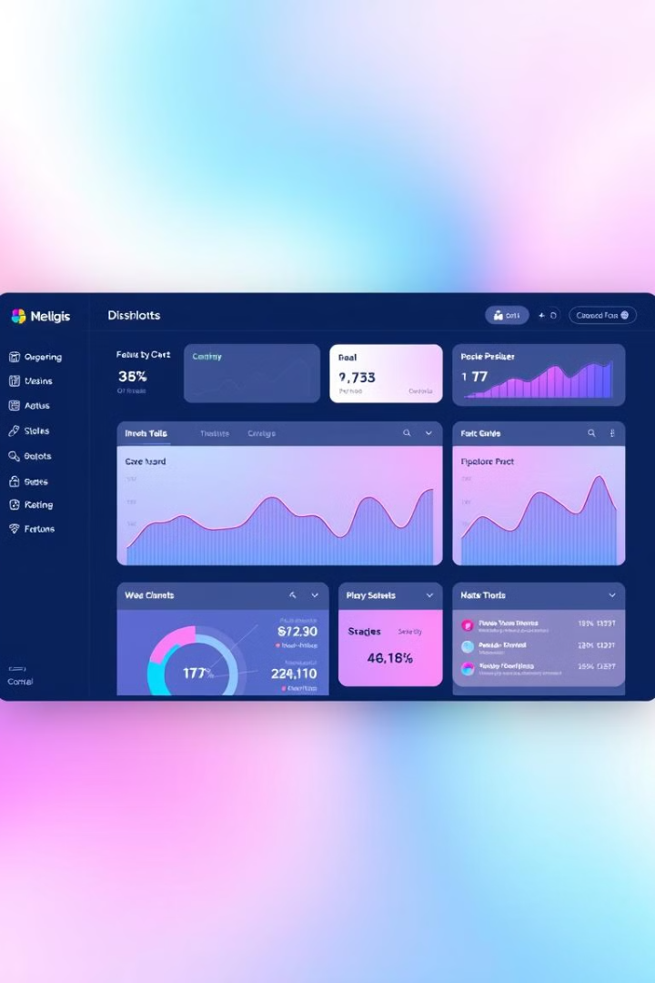
3. Website Traffic
Start date: October 15th
Minimum Cost: 4,000 EGP
Action 1:
Action 2:
Action 3:
Website Creation
SEO Optimization & Google Ads
Implement best practices to improve organic search visibility.
Informative Content
Publish regular blog posts that provide value to visitors.

Slide 20
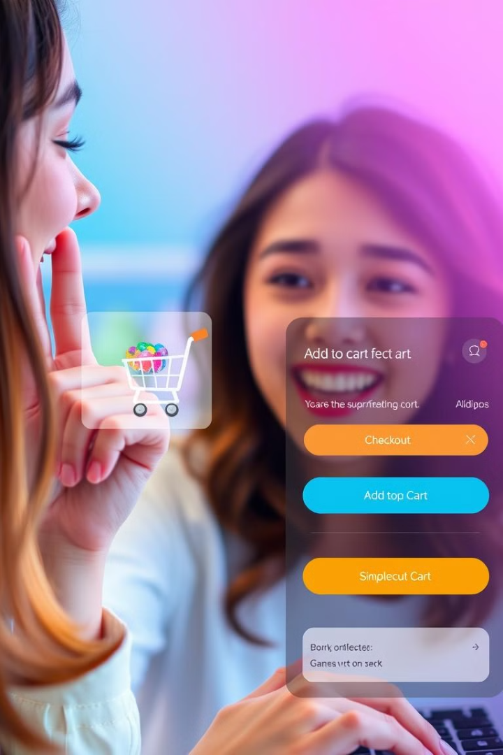
4. Conversion Rate
Start date: On February
Minimum Cost: 5,000EGP
Optimize Landing Pages
Improve user experience and calls to action on landing pages.
A/B Testing
Test different elements on the website and social media.
Retargeting Ads
Use retargeting ads to re-engage potential customers.

Slide 21
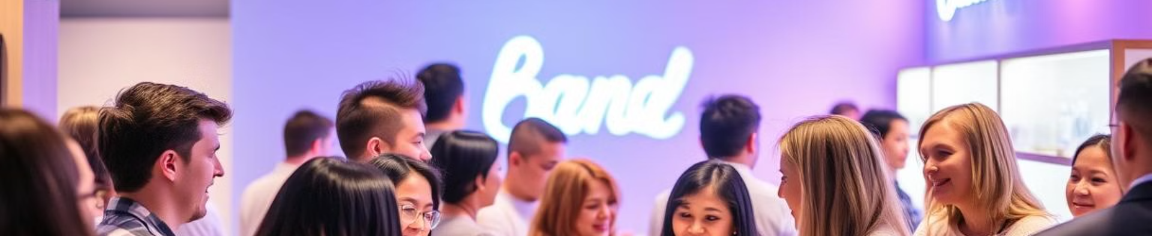



Customer Retention
Loyalty Program
Customer Feedback
Post-Purchase Engagement
Implement a program that rewards repeat purchases.
Collect feedback to improve the customer experience.
Follow up with customers after purchases to keep them engaged.

Slide 22
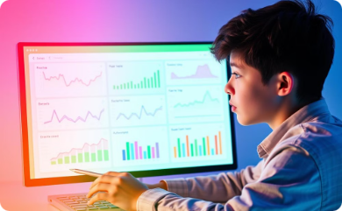
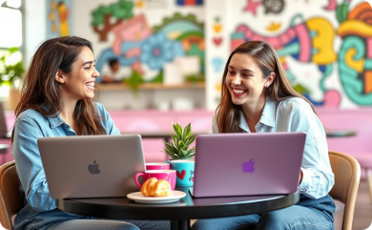
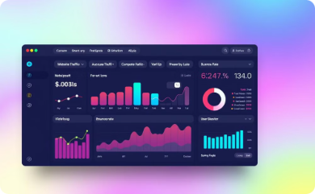
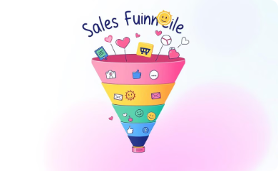
Key Performance Indicators (KPIs)
Brand Awareness
Social Media Growth & Engagement
Website Traffic
Conversation Rate
3000 Total visit monthly
35:45 Successful Conversion monthly
25:15 Cart abandonment monthly
10% : 25% Revenue growth monthly
15,000 Impressions weekly
54000 Reach weekly
100 Search volume monthly
3,000 new followers monthly
1,500 increase engagement rate monthly

Slide 23

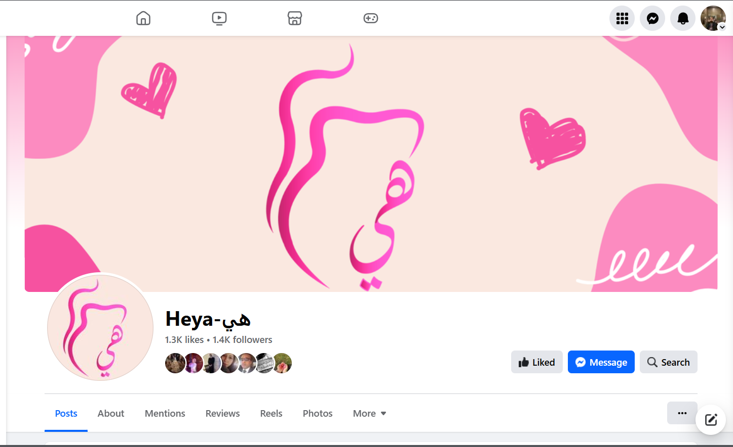

Slide 24
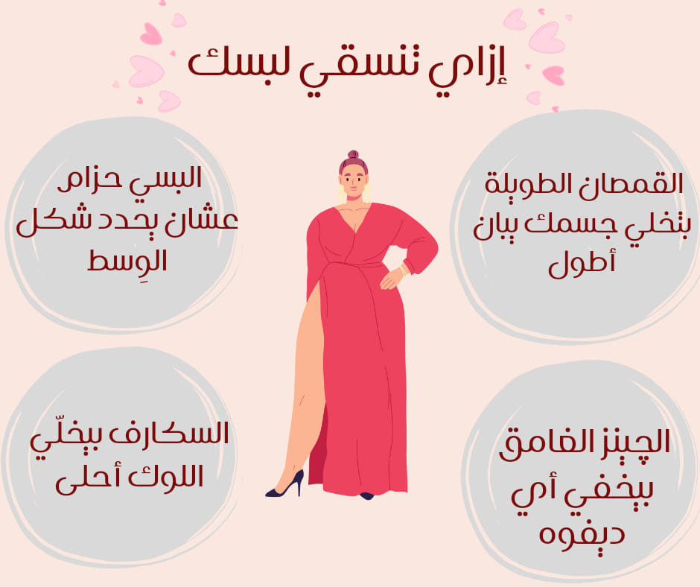

Slide 25
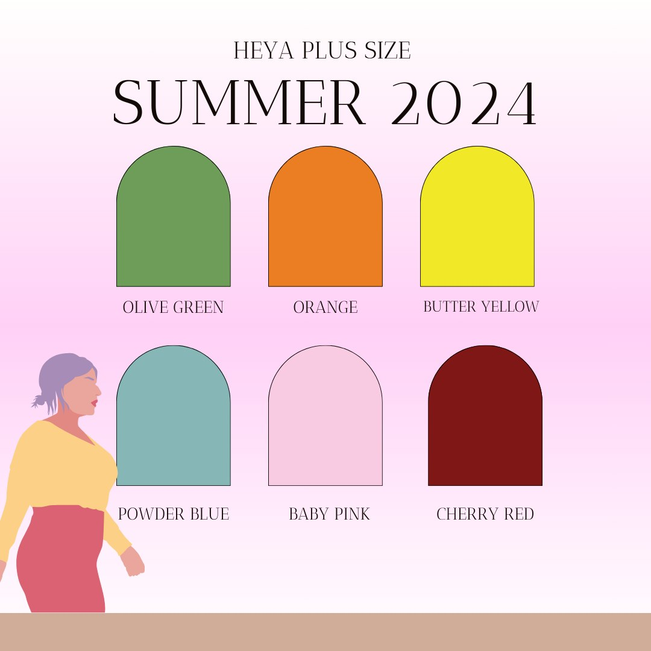

Slide 26
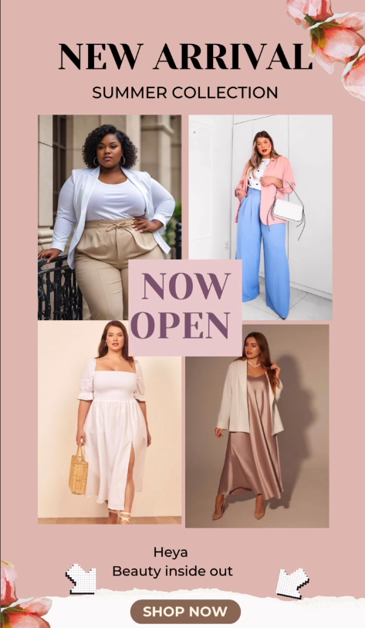
Instagram Reel

Slide 27
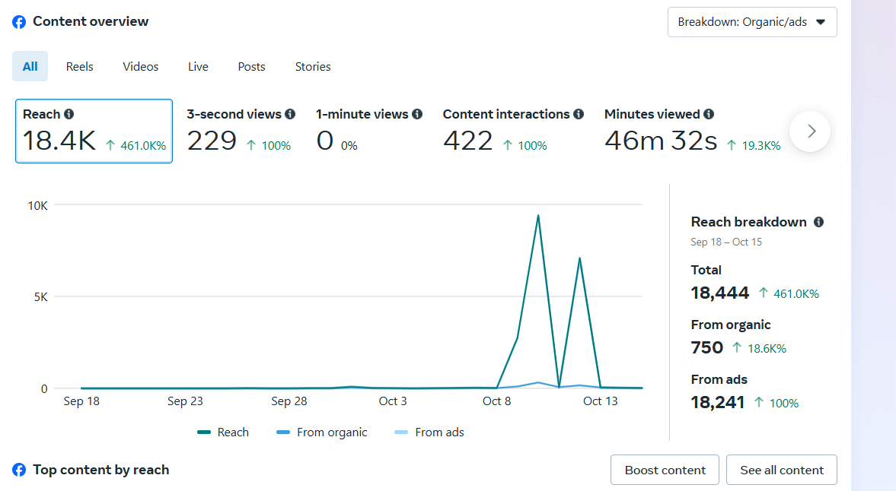

Slide 28
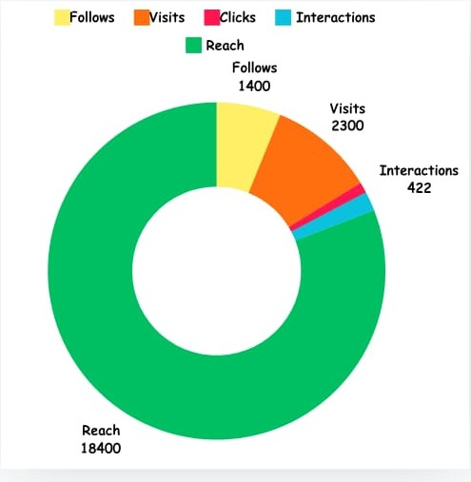
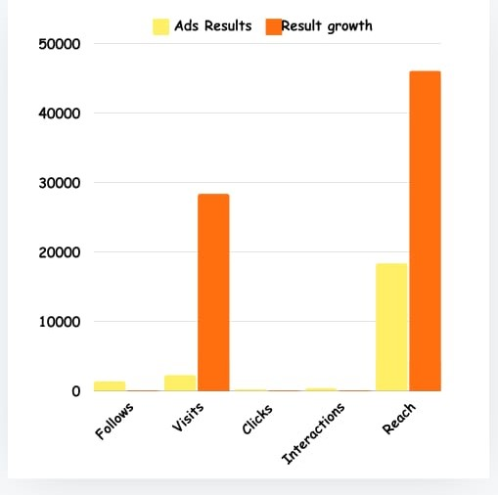

Slide 29
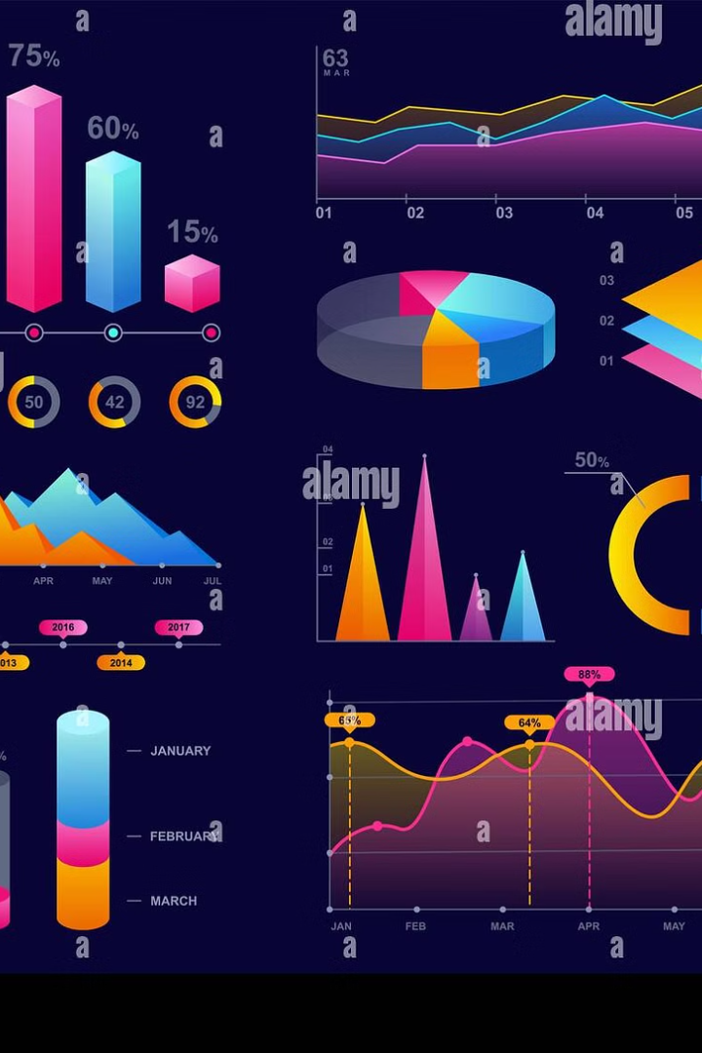
Control, Insights and Improvements|
Facebook engagement analysis reveals low interaction despite strong impressions.
Most posts had very low minutes viewed

Slide 30
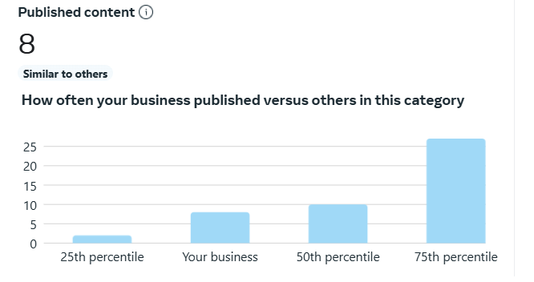
Increase Publication Frequency
1
Current Frequency
Our current publication frequency is below the industry median.
2
Increase Frequency
Increase publication frequency to match or exceed industry standards.
3
Monitor Impact
Track engagement metrics to assess the impact of increased frequency.

Slide 31

Target Audience Content
Audience Insights
1
Targeted Audience
2
3
Engagement Strategy
Use Facebook's audience insights to identify segments that responded well to the ads.
Develop engaging content that resonates with this target audience.
Our Facebook ads target women aged 25 to 44.

Slide 32
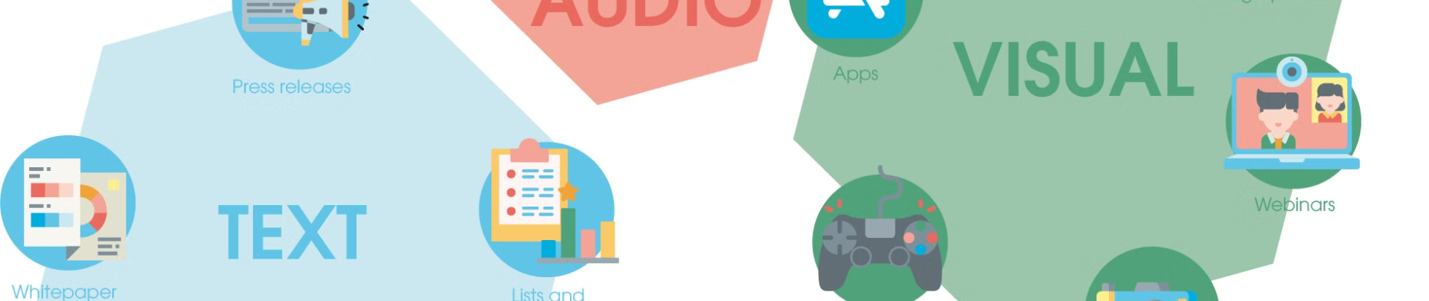
Experiment with Visual Formats
Carousel Format
Video and Reels
Experiment with carousel photo formats to enhance visual appeal.
Focus on creating engaging videos and reels to capture audience interest.

Slide 33




Engagement Strategies
Clear CTAs
A/B Testing
Influencer Collaboration
Include clear CTAs in posts to invite followers to engage.
Consider A/B testing different types of posts to see what resonates better with the audience.
Implement retargeting campaigns to re-engage previous viewers.
Collaborate with influencers to extend reach and engagement.

Slide 34
Content Enhancement
Creative Design
High-Quality Visuals
Enhance content with a creative designer for better engagement.
Use high-quality images and videos to enhance visual appeal.

Slide 35





Cross Promotion
Facebook Stories
Publish stories on both Facebook and Instagram.
Instagram Stories
Publish stories on both Facebook and Instagram.
User Generated Content
Encourage user generated content to increase engagement.
Feature Reviews
Feature reviews and testimonials to build trust and credibility.

Slide 36

Any Questions?
Open to questions and discussion.

